Slide 1

Visual Search
Giovanni Marchetti – Software Engineer
Mariya Zorotovich – Program Manager

Slide 2

Visual Search Engines
What
Retrieve information using images as input
Produce images and / or text as output
Why
¾ of internet users search for pictures before a purchase
¾ of consumers find text search inefficient
Proliferation of devices and abundance of content

Slide 3
Major Users
eBay Image Search
Pinterest Lens
Google Lens
Bing Visual Search
Neiman Marcus
Target

Slide 4

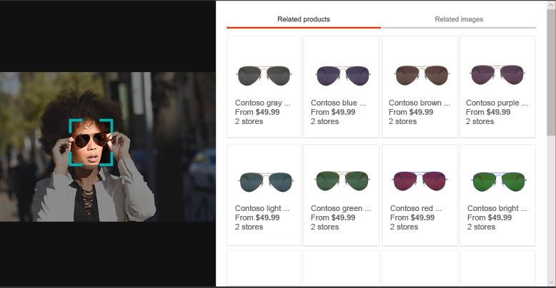

Bing Visual Search
Enhance
Create compelling recommendations using visually similar images
Add
Integrate any image source to get intelligent search annotations and information
Augment Extract textual information and read text in images for improved search results

Slide 5
Build Your Own
When you have your own catalogue
When you have your own metadata
When you don’t want to show up in a search result with your competitor

Slide 6

Data Sources
Deep Fashion Dataset
Fashion MNIST
Your Own – needs not be fashion!

Slide 7
Encoding
Deep Neural Networks
Transfer Learning
Feature Extraction
Semantic Hash

Slide 8

Deep Neural Networks

Slide 9
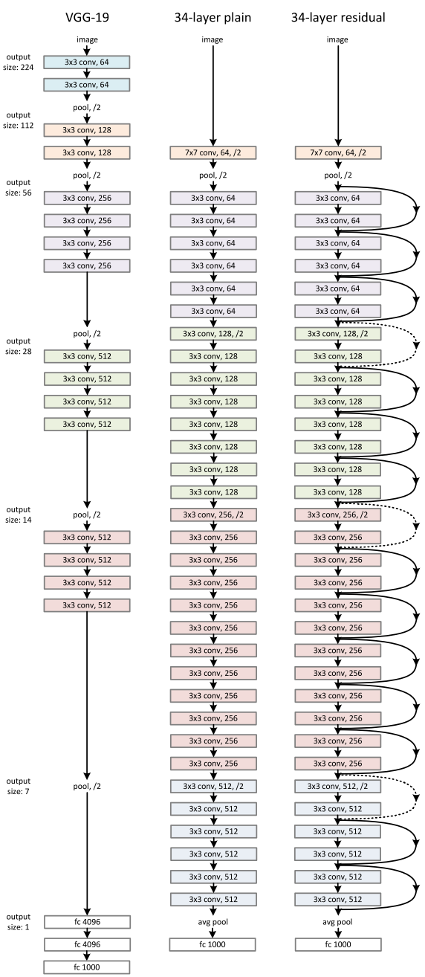
Transfer Learning
Convolutional Neural Networks
Good at detecting features in images
Transfer
Take pre-trained layers for feature detection
Insert and train new classifiers for own dataset
”Famous” networks:
VGG16/19 – Oxford University
ResNet18/34/50 - Microsoft
Inception v3/4 - Google

Slide 10

Feature Extraction
Get output of layer before the classifier
base_model.summary()
Layer (type) Output Shape Param # Connected to
==================================================================================================
input_9 (InputLayer) (None, 224, 224, 3) 0
__________________________________________________________________________________________________
conv1_pad (ZeroPadding2D) (None, 230, 230, 3) 0 input_9[0][0]
__________________________________________________________________________________________________
conv1 (Conv2D) (None, 112, 112, 64) 9472 conv1_pad[0][0]
__________________________________________________________________________________________________
bn_conv1 (BatchNormalization) (None, 112, 112, 64) 256 conv1[0][0]
__________________________________________________________________________________________________
activation_393 (Activation) (None, 112, 112, 64) 0 bn_conv1[0][0]
__________________________________________________________________________________________________
max_pooling2d_9 (MaxPooling2D) (None, 55, 55, 64) 0 activation_393[0][0]
<…a lot more layers…>
avg_pool (AveragePooling2D) (None, 1, 1, 2048) 0 activation_441[0][0]
__________________________________________________________________________________________________
flatten_9 (Flatten) (None, 2048) 0 avg_pool[0][0]
__________________________________________________________________________________________________
fc1000 (Dense) (None, 1000) 2049000 flatten_9[0][0]
==================================================================================================
Total params: 25,636,712
Trainable params: 25,583,592
Non-trainable params: 53,120
Cut here

Slide 11

Demo
Feature Extraction

Slide 12
Technologies
Azure Deep Learning Virtual Machine
NC-class, 4 GPUs
GPUs accelerate computation by orders of magnitude
Jupyter Notebooks with Python 3.6
Keras library for deep neural networks

Slide 13
Distances
Euclidean
Hamming
Cosine – trig.
Cosine – vect.

Slide 14
Demo
Distance Computation

Slide 15

Effect of Distance Measures
Euclidean
Hamming

Slide 16
Semantic Hash
What
A method to map a document (or picture) to a code
The code can be binary
Mostly used in document retrieval
Why
Binary is fast and efficient!
Hd = BIT_COUNT(a XOR b)

Slide 17
Encoding
Insert a layer to produce the hash code
Retrain (part of) the network
Extract the code
Post-process if necessary
Store

Slide 18
Activation Functions
Tanh
Sigmoid

Slide 19

Storage Layer & Search
Scale requirements – possibly millions of images.
2^64 ~ 1.845*10^19
Store the code with the image (or pointer to the image)
Offload the search
Which DB engine can compute Hamming distance?
MySQL: BIT_COUNT(a^b)
v8.0 allows more than 64 bits
SQL: user-defined function, limitation on XOR types
CosmosDB: user-defined function

Slide 20
Demo
Search with Hash Code

Slide 21
Search Results
64-bit Code
Accuracy ~ 70% after 100 epochs
128-bit Code
About same in 40 epochs

Slide 22
Approximate Nearest Neighbors
At scale, cannot scan whole table to compute distance!
Reduce the search space: use category information, other metadata
Use approximate nearest-neighbor algorithms with hash code
E.g. Spotify’s Annoy https://github.com/spotify/annoy
Max. flexibility, alas they run out of db process
Build ANN / kNN algorithms into DB
E.g. PostgreSQL with Cube extension https://www.postgresql.org/docs/current/static/cube.html
Limited variety of distances

Slide 23
Technologies
Azure MySQL
Fully managed MySQL 5.7 (as of writing)
Worth Considering:
Azure PostgreSQL

Slide 24
Next Steps
Bing Visual Search API
Azure Deep Learning VM
Azure MySQL
Azure PostgreSQL

